Slide 1
Azure Data Explorer
SURYA MAHESH KOLISETTY

Slide 2
What is Azure Data Explorer (ADX) ?
Azure Data Explorer is fully managed, high performance, big data analytics platform that makes it easy to analyze high volumes of data.
It helps you to ingest data (structured,semi structured & non structured (free text)) and perform near real time interactive analytics.
The Azure Data Explorer toolbox gives you an end-to-end solution for data ingestion, query, visualization, and management.

Slide 3
Azure Data Explorer: A Powerful Tool for Data Analytics
By analyzing structured, semi-structured, and unstructured data across time series, and by using Machine Learning, Azure Data Explorer makes it simple to extract key insights, spot patterns and trends, and create forecasting models.
Azure Data Explorer uses a traditional relational model, organizing data into tables with strongly-typed schemas. Tables are stored within databases, and a cluster can manage multiple databases.
Azure Data Explorer is scalable, secure, and is useful for log analytics, time series analytics, IoT, and general-purpose exploratory analytics.

Slide 4
What makes Azure Data Explorer unique?
Data velocity, variety, and volume: Ingest and query terabytes/petabytes of data in minutes in batch or streaming mode.
User-friendly query language: Kusto - open-source language (KQL).
Advanced analytics: Time series analysis & Python code can be embedded in KQL queries.
Easy-to-use wizard: Ingestion Wizard - easy to use.
Versatile data visualization: Built-in visualization and dashboards. Native integration with Power BI.
Automatic ingest, process, and export: Continuous ingestion and export to ADLS.
Integration with other services.

Slide 5
ADX – Workflow
Create database:
Create a cluster.
Create one or more databases within that cluster. Each cluster can hold up to 10,000 databases, and each database can hold up to 10,000 tables.
Data in each table is stored in data shards, also called "extents".
Ingest data:
Load data into database tables.
Query database:
Use the Kusto query language (KQL) to query and analyze data.
Visualize results:
Create visualizations and dashboards to explore and present the results.

Slide 6
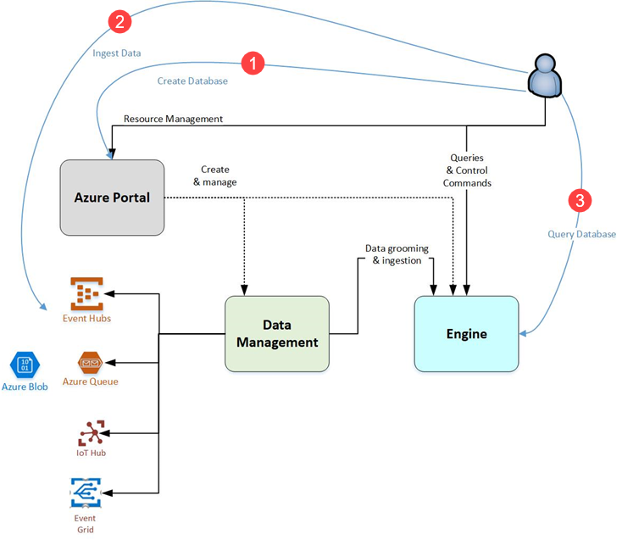

Slide 7
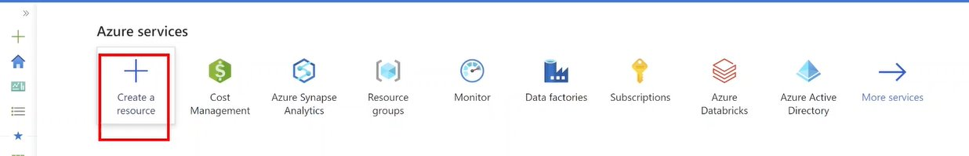
Create Azure Data Explorer Cluster and Database
Go to Portal.azure.com ---- Hit Create a Resource
ADX is also one of the service provided by Azure

Slide 8
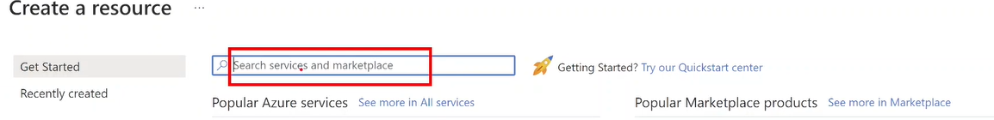
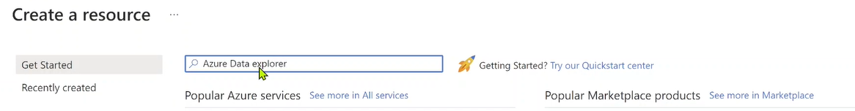
Create Azure Data Explorer Cluster and Database
2. Search for ADX

Slide 9
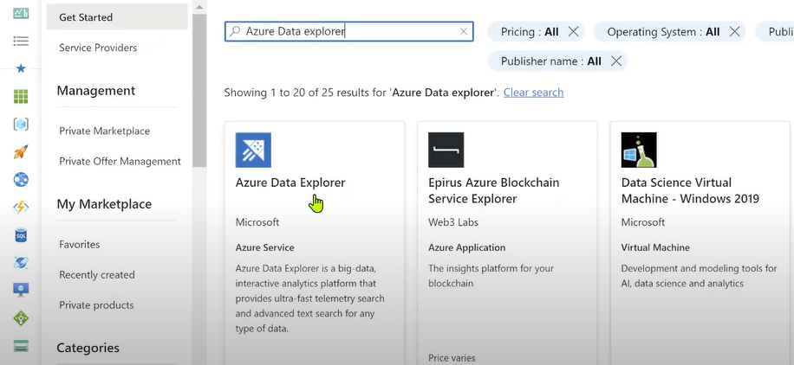
Create Azure Data Explorer Cluster and Database
3.Select Azure Data Explorer

Slide 10
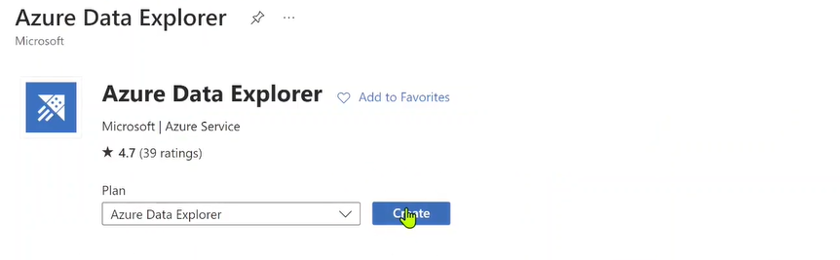
Create Azure Data Explorer Cluster and Database
4.Hit Create button to Create ADX Cluster

Slide 11
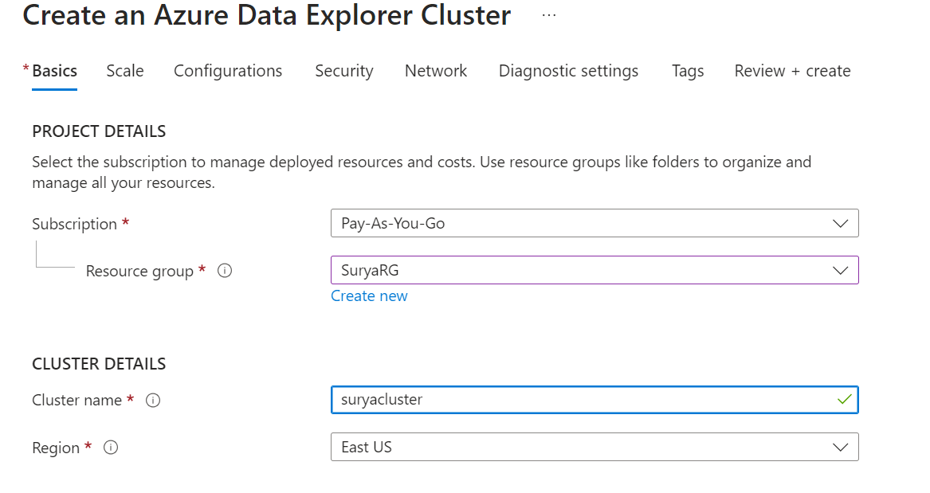
Create Azure Data Explorer Cluster and Database

Slide 12
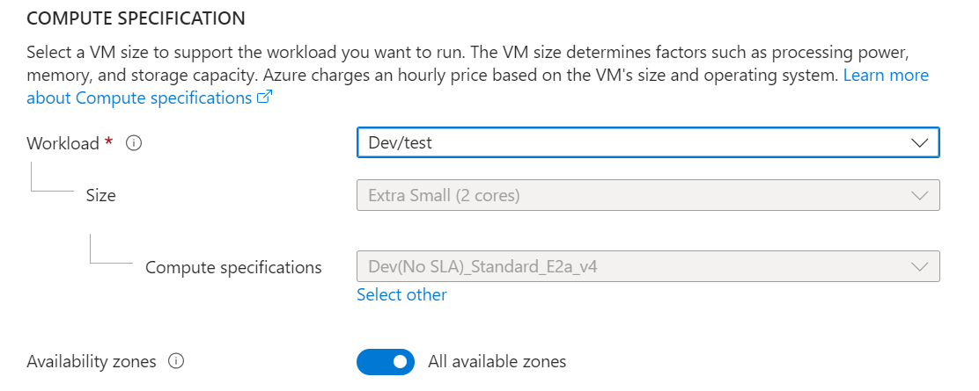
Create Azure Data Explorer Cluster and Database
5. Select Workload – Dev/test - for developing and testing

Slide 13
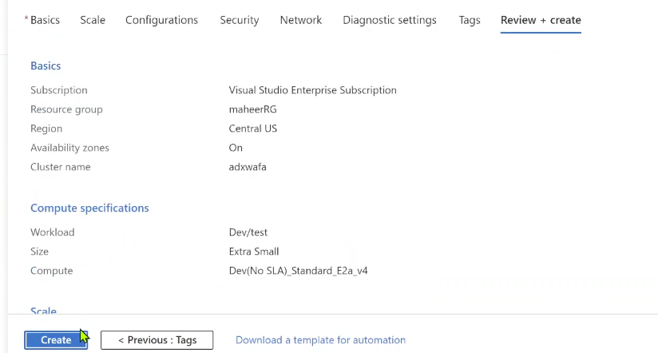
Create Azure Data Explorer Cluster and Database
6. Click Review + create –-- Once validation done --- Hit Create

Slide 14
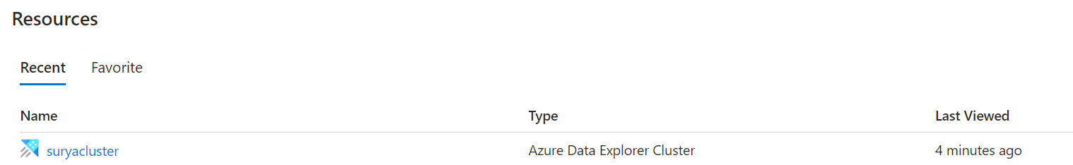
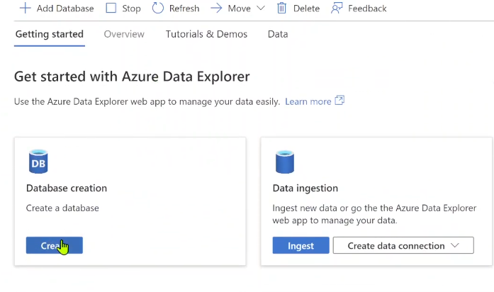
Create Azure Data Explorer Cluster and Database
7. Move to Cluster in Home Page --- Create a Database

Slide 15
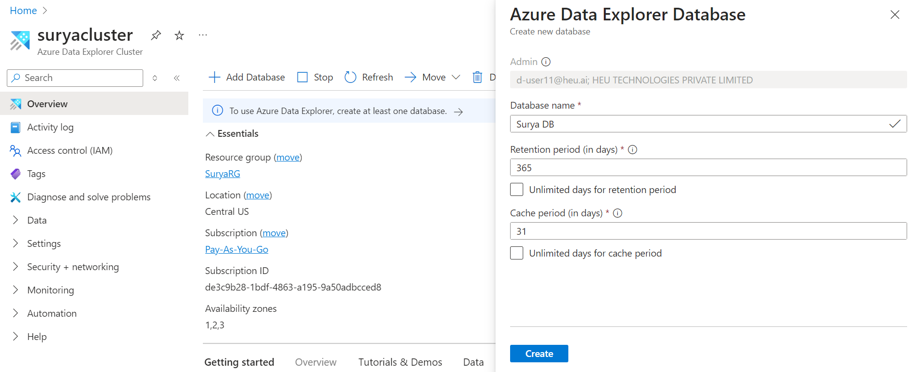
Create Azure Data Explorer Cluster and Database
8.Database Creation

Slide 16
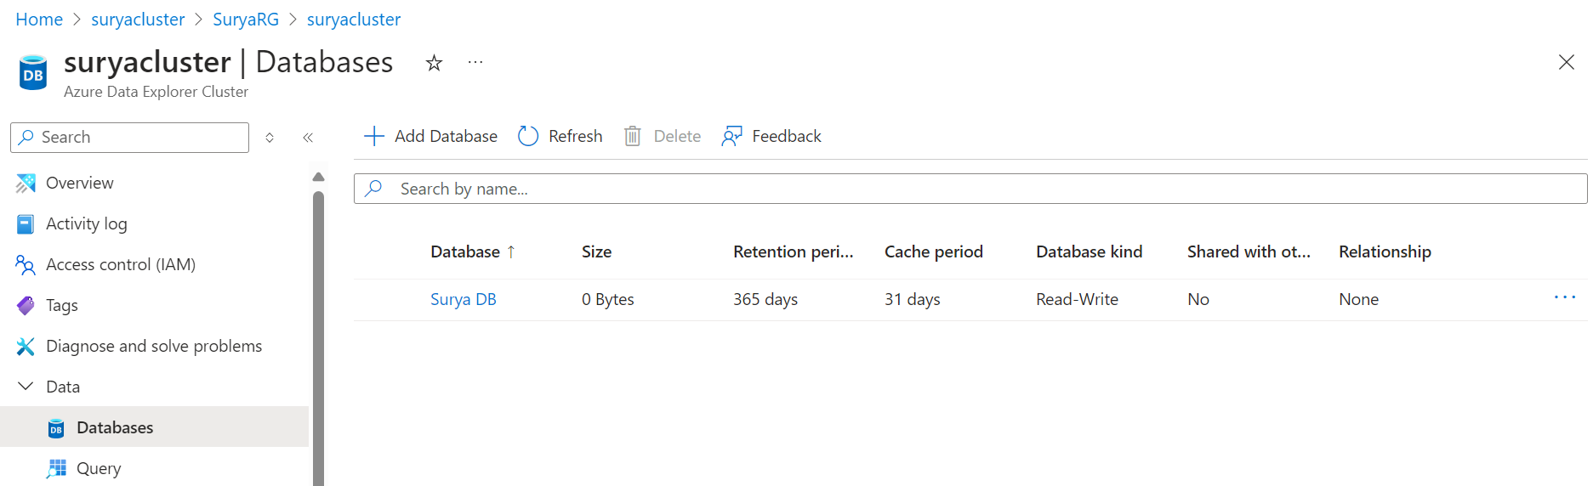
Create Azure Data Explorer Cluster and Database
9.After Successful Database Creation Navigate to Databases inside Cluster

Slide 17
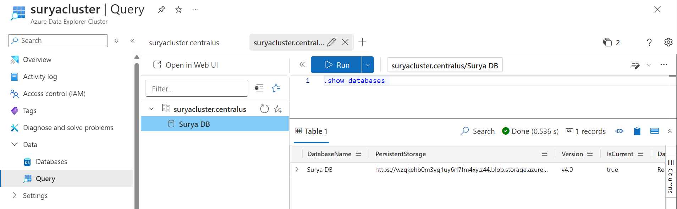
Create Azure Data Explorer Cluster and Database
10. Navigate to Query under Databases
.show databases #shows all the databases in the cluster

Slide 18
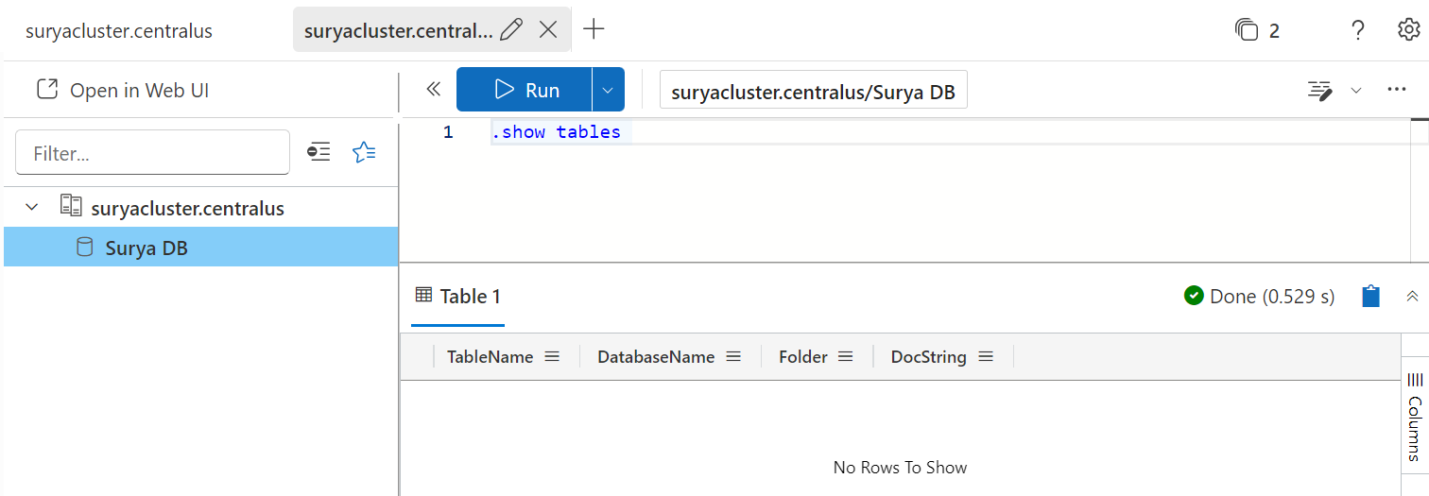
Create Azure Data Explorer Cluster and Database
11. Query
.show tables #shows all the tables in the database

Slide 19
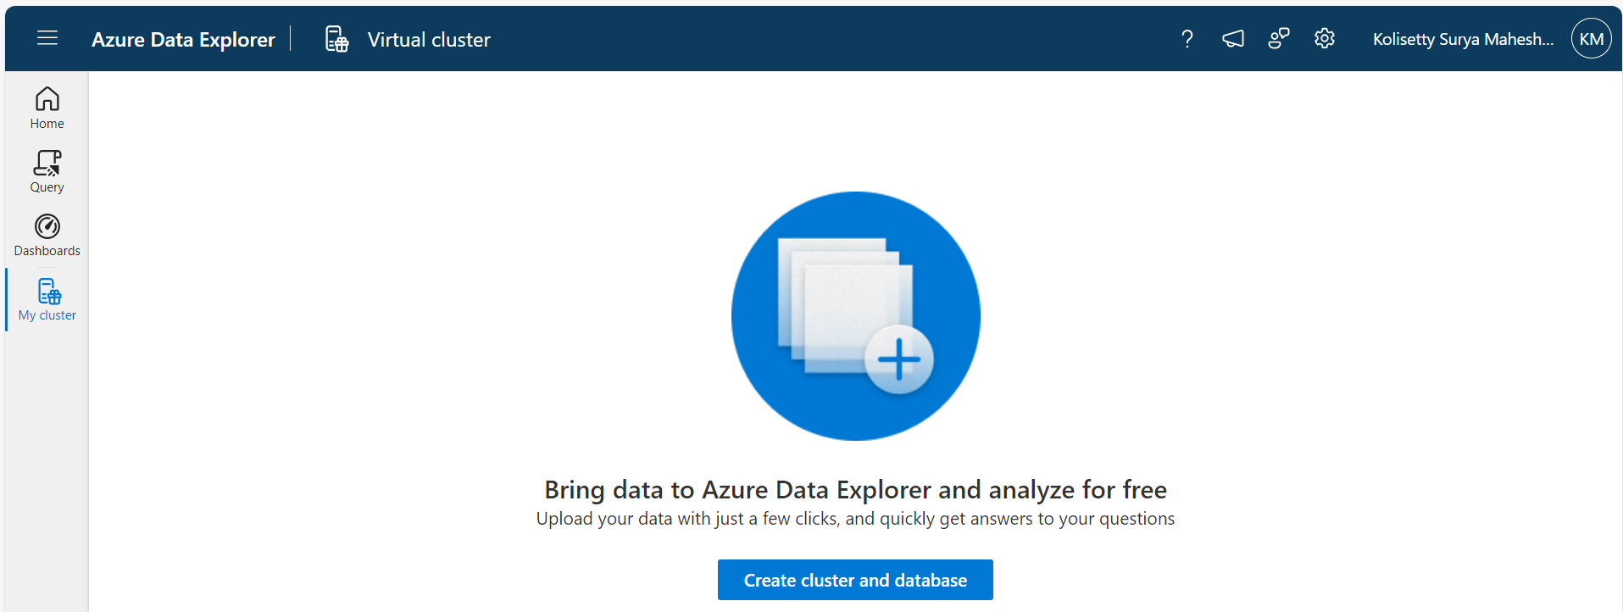
Create Azure Data Explorer Cluster and Database
12. Create Cluster and Database without Azure Subscription – We just need Microsoft Acc
Goto https://dataexplorer.azure.com - Create cluster and Database

Slide 20
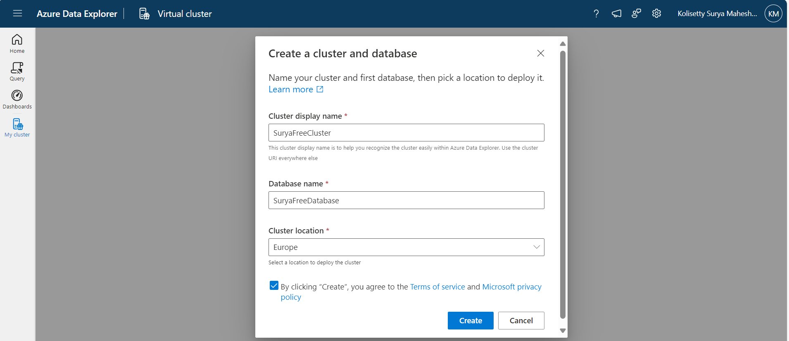
Create Azure Data Explorer Cluster and Database
13. Create Cluster and Database without Azure Subscription

Slide 21
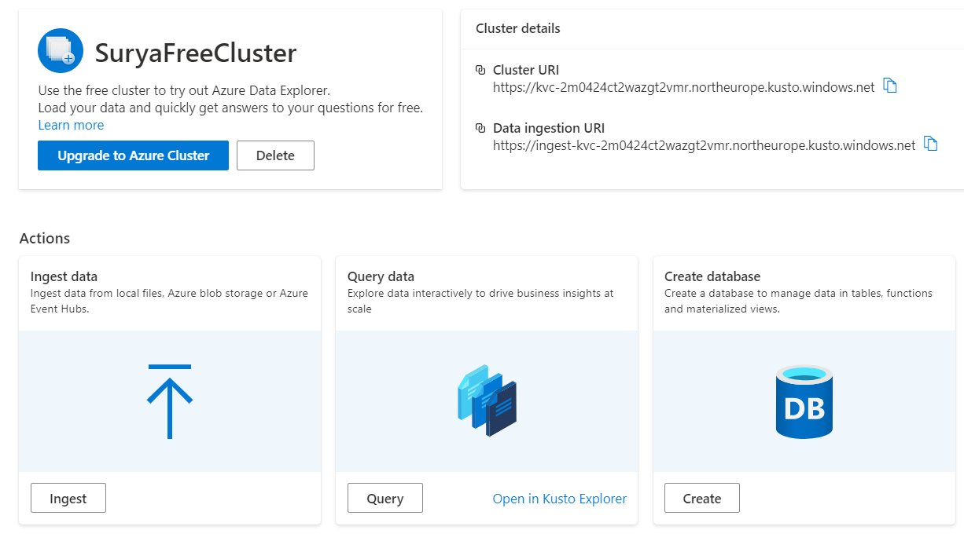
Data Ingestion into ADX Cluster
14.Navigate to SuryaFreeCluster – Ingest Sample data to ADX

Slide 22
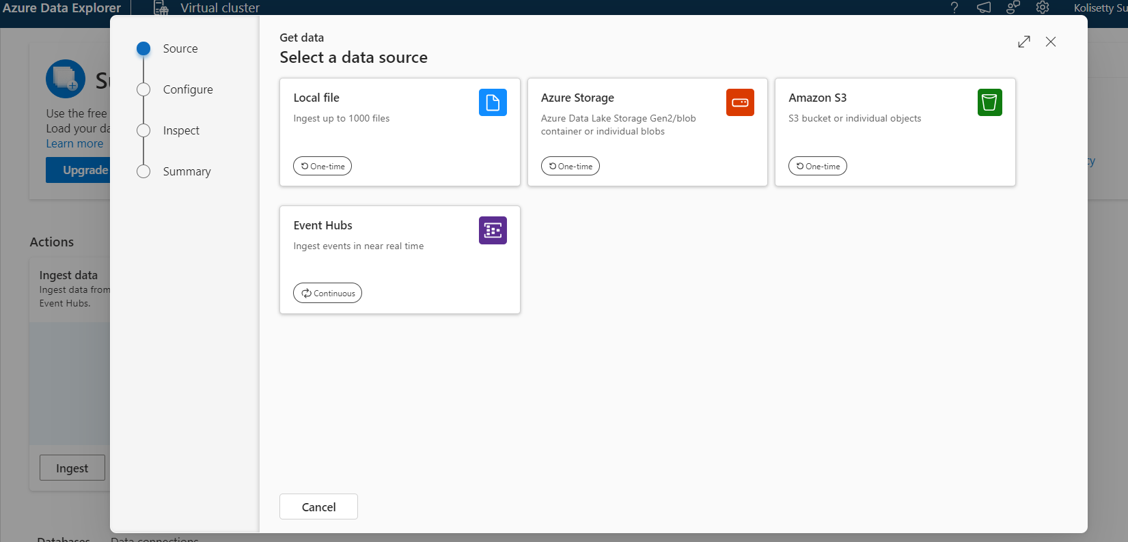
Data Ingestion into ADX Cluster
15. Ingest Data --- Local file

Slide 23
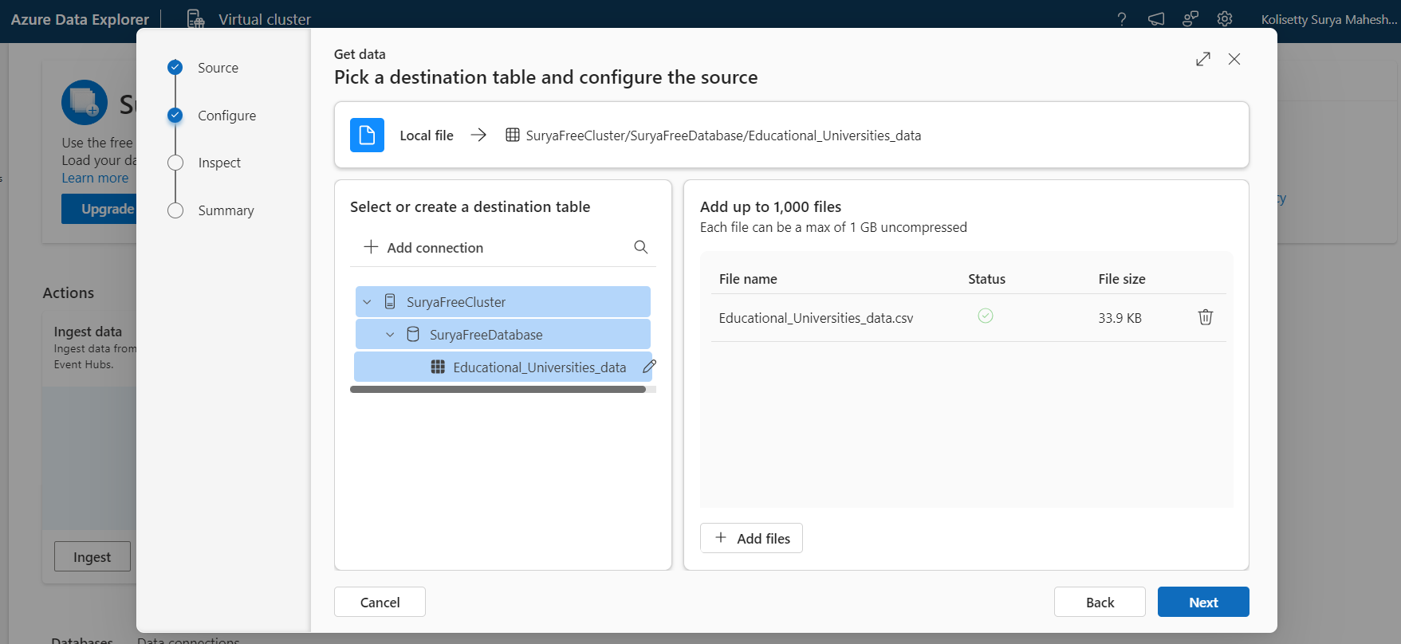
Data Ingestion into ADX Cluster
16. Select local file to ingest the data

Slide 24
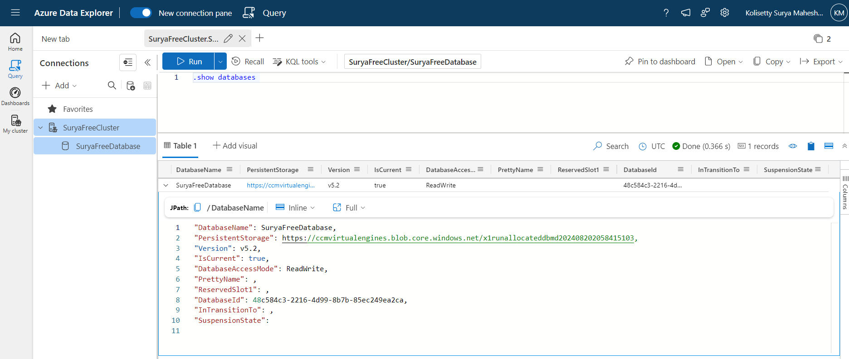
Query Sample Data Using Kusto in ADX
17. Query data
.show databases

Slide 25

Query Sample Data Using Kusto in ADX
18. Query data
.show tables

Slide 26
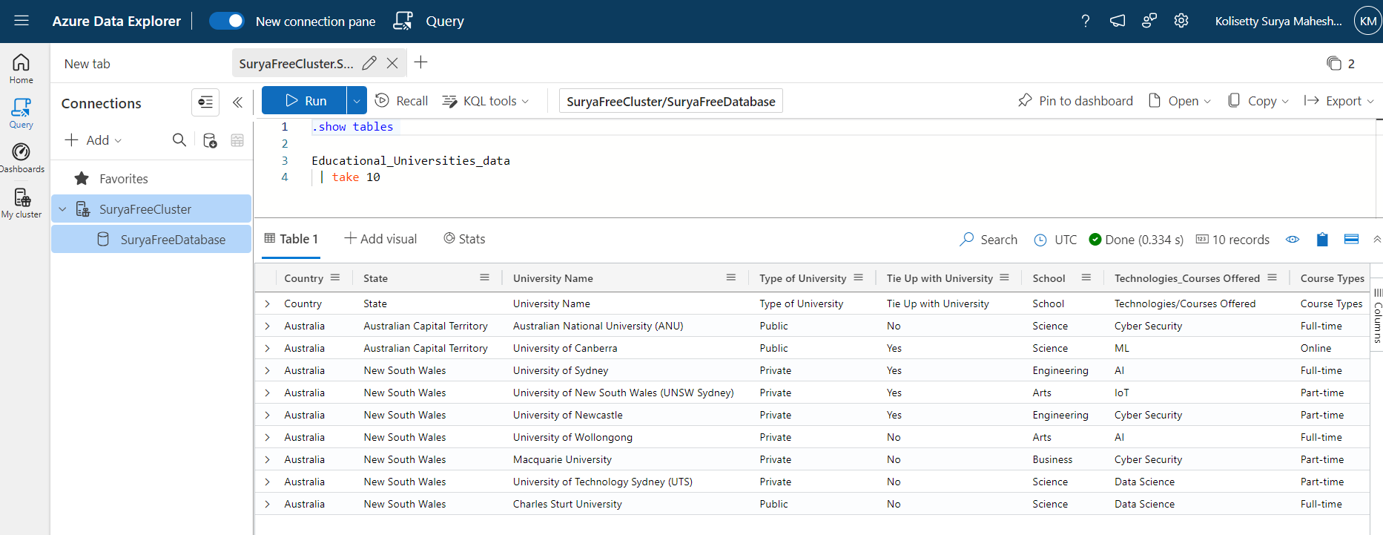
Query Sample Data Using Kusto in ADX
19. Query data
Educational_Universities_data | take 10

Slide 27
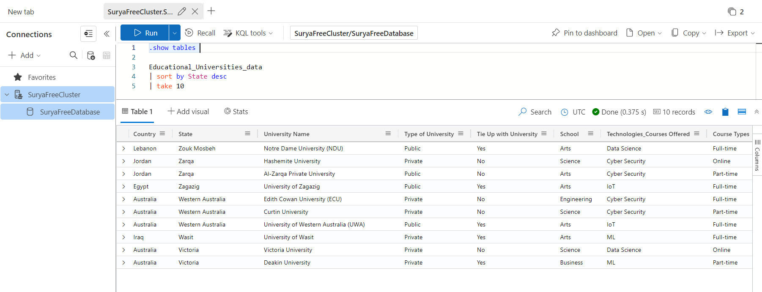
Query Sample Data Using Kusto in ADX
20. Query data
Educational_Universities_data | sort by State desc | take 10

Slide 28
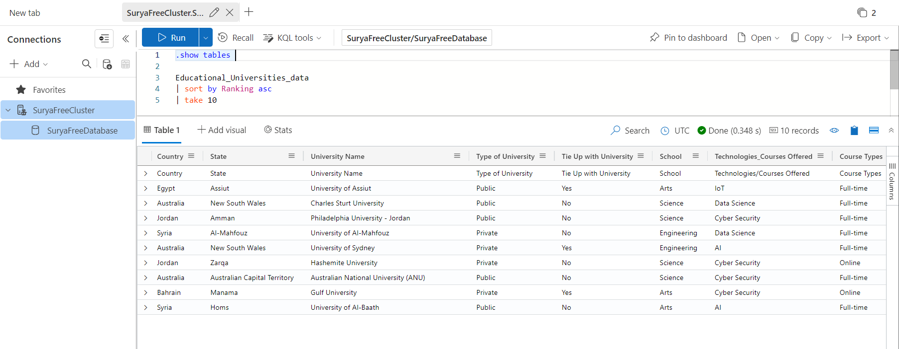
Query Sample Data Using Kusto in ADX
21. Query data
Educational_Universities_data | sort by Ranking asc | take 10

Slide 29
KQL - Queries
.show databases
.show tables
Educational_Universities_data
Educational_Universities_data|take 10
Educational_Universities_data|sort by State desc|take 10
Educational_Universities_data|sort by Ranking asc|take 10
Educational_Universities_data|where Country == "Australia" and State == "New South Wales"
Educational_Universities_data|where Country == "Australia" and State == "New South Wales"|take 10
Educational_Universities_data|where Country == "Australia" and State == "New South Wales"|sort by School asc|take 10

Slide 30
KQL - Queries
Educational_Universities_data|count
Educational_Universities_data|summarize Count=count() by State
Educational_Universities_data|summarize Count=count() by Country
Educational_Universities_data|summarize SchoolCount=count() by School
Educational_Universities_data|summarize SchoolCount=count() by School|render columnchart
Educational_Universities_data|summarize SchoolCount=count() by School|where SchoolCount > 10|render columnchart
Educational_Universities_data|summarize SchoolCount=count() by School|project School,SchoolCount

Slide 31
KQL - Queries
Educational_Universities_data|join universities_data on $left.Country == $right.Country
Educational_Universities_data|join universities_data on $left.Country == $right.Country|take 10
Educational_Universities_data|join universities_data on $left.Country == $right.Country|sort by State|take 10
Educational_Universities_data|join Educational_Institutions on $left.State == $right.State
Educational_Universities_data|join Educational_Institutions on $left.State == $right.State|take 10
Educational_Universities_data|join Educational_Institutions on $left.State == $right.State|sort by Country|take 10

Slide 32
KQL - Queries
Educational_Universities_data|distinct State
Educational_Universities_data|distinct Country
Educational_Universities_data|distinct State|count
Educational_Universities_data|distinct Country|count
Educational_Universities_data|project Country,State,Ranking
Educational_Universities_data|take 10|project Country,State,Ranking
Educational_Universities_data|sort by Ranking|project Country,State,Ranking

Slide 33
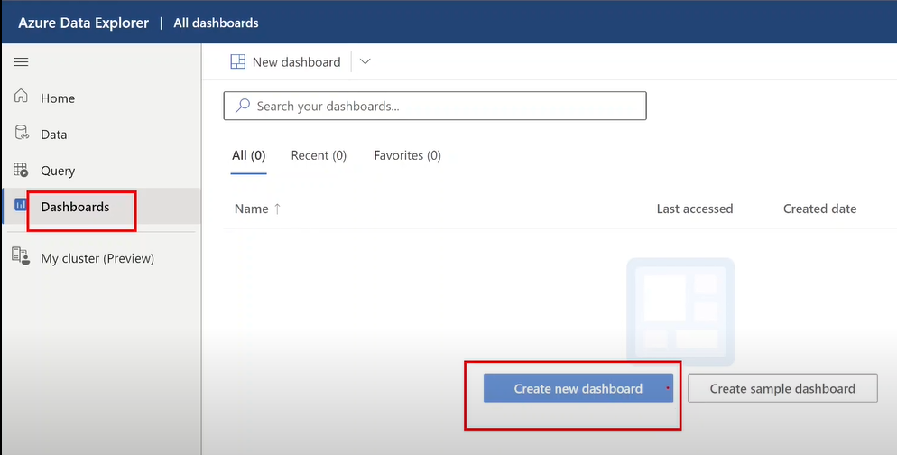
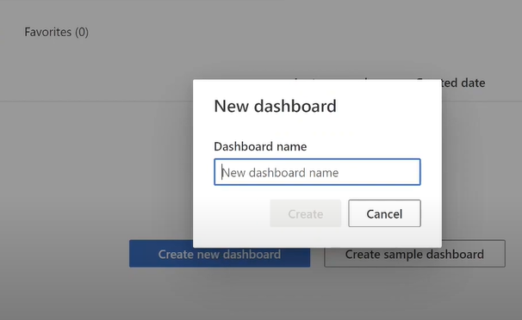
Visualize data with Azure Data Explorer (ADX) dashboards
21.Navigate to Dashboards Section ,Create Dashboard

Slide 34
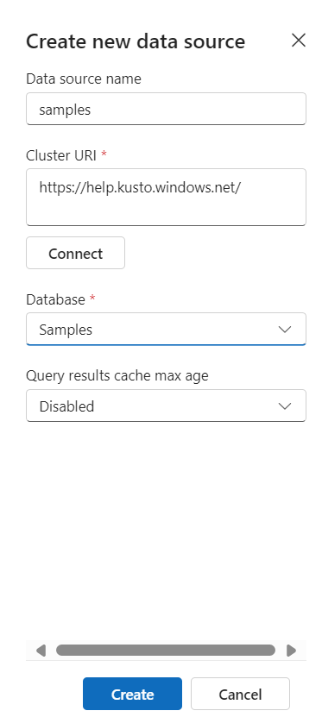
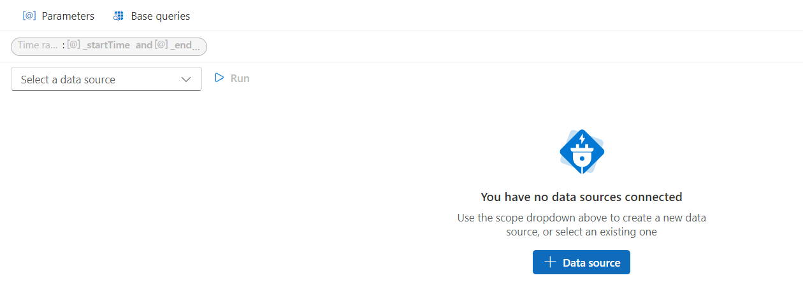
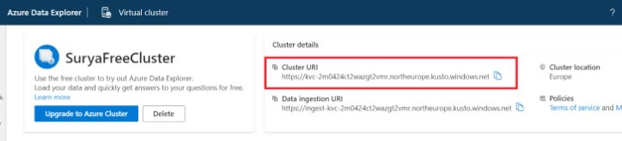
Visualize data with Azure Data Explorer (ADX) dashboards
22. Add Tile , Add Data source

Slide 35
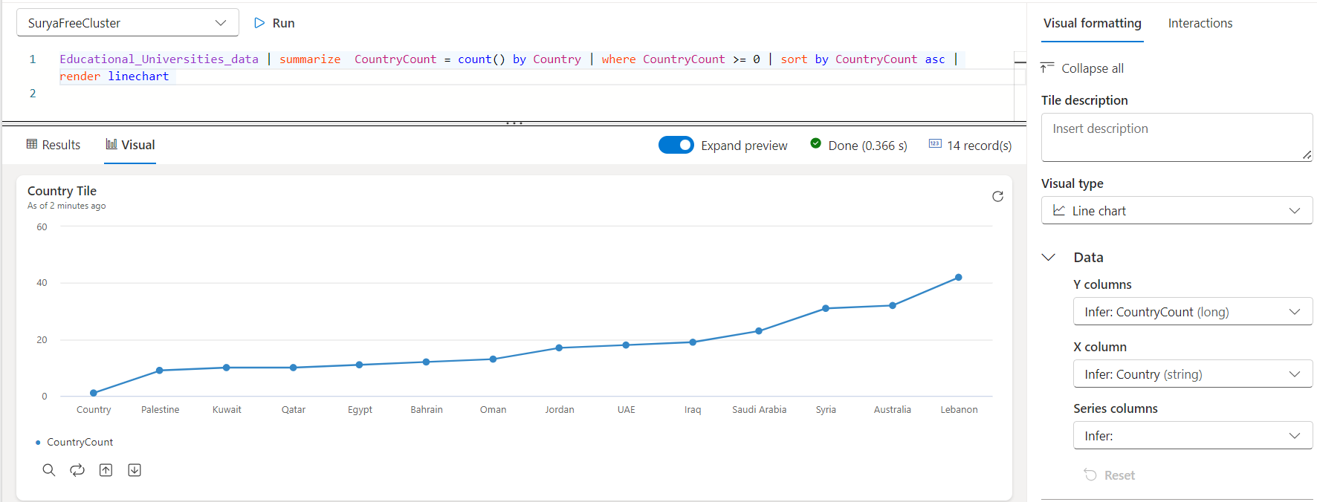
Visualize data with Azure Data Explorer (ADX) dashboards
23. Run KQL Query , Add Visual

Slide 36
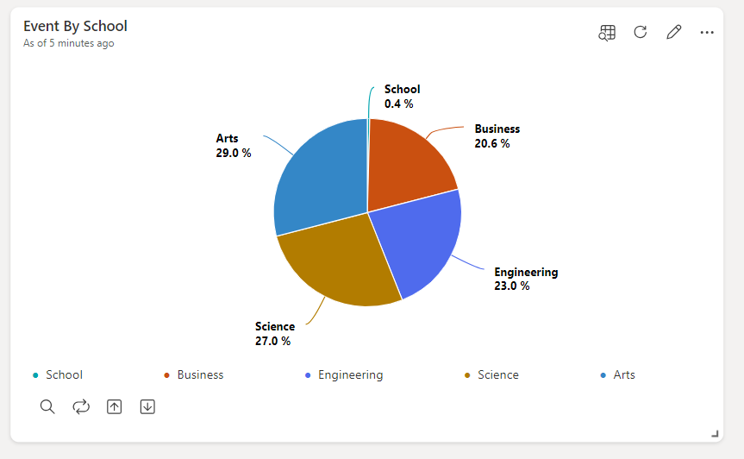
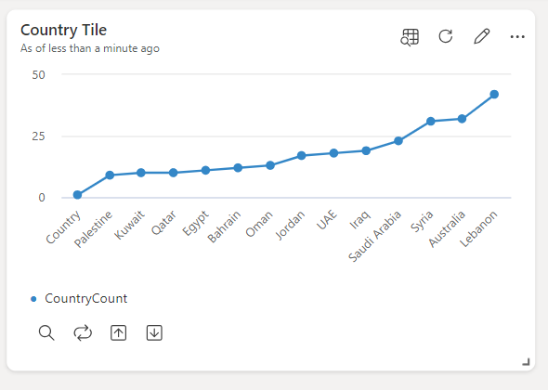
Visualize data with Azure Data Explorer (ADX) dashboards
24. Dashboard

Slide 37
Ingestion wizard in Azure Data Explorer (ADX)
25. Ingestion wizard is user interface for ingesting data

Slide 38
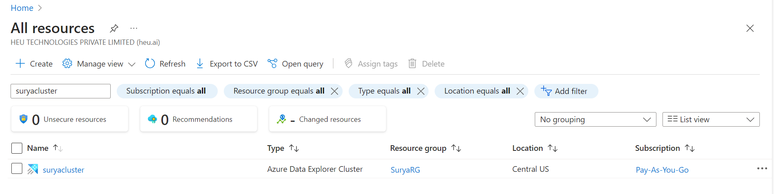
Ingestion wizard in Azure Data Explorer (ADX)
26. Let's connect Azure Data Explorer Cluster to Web UI Cluster
Navigate to https://portal.azure.com/ --- All Resources
Search for the ADX Cluster over here

Slide 39
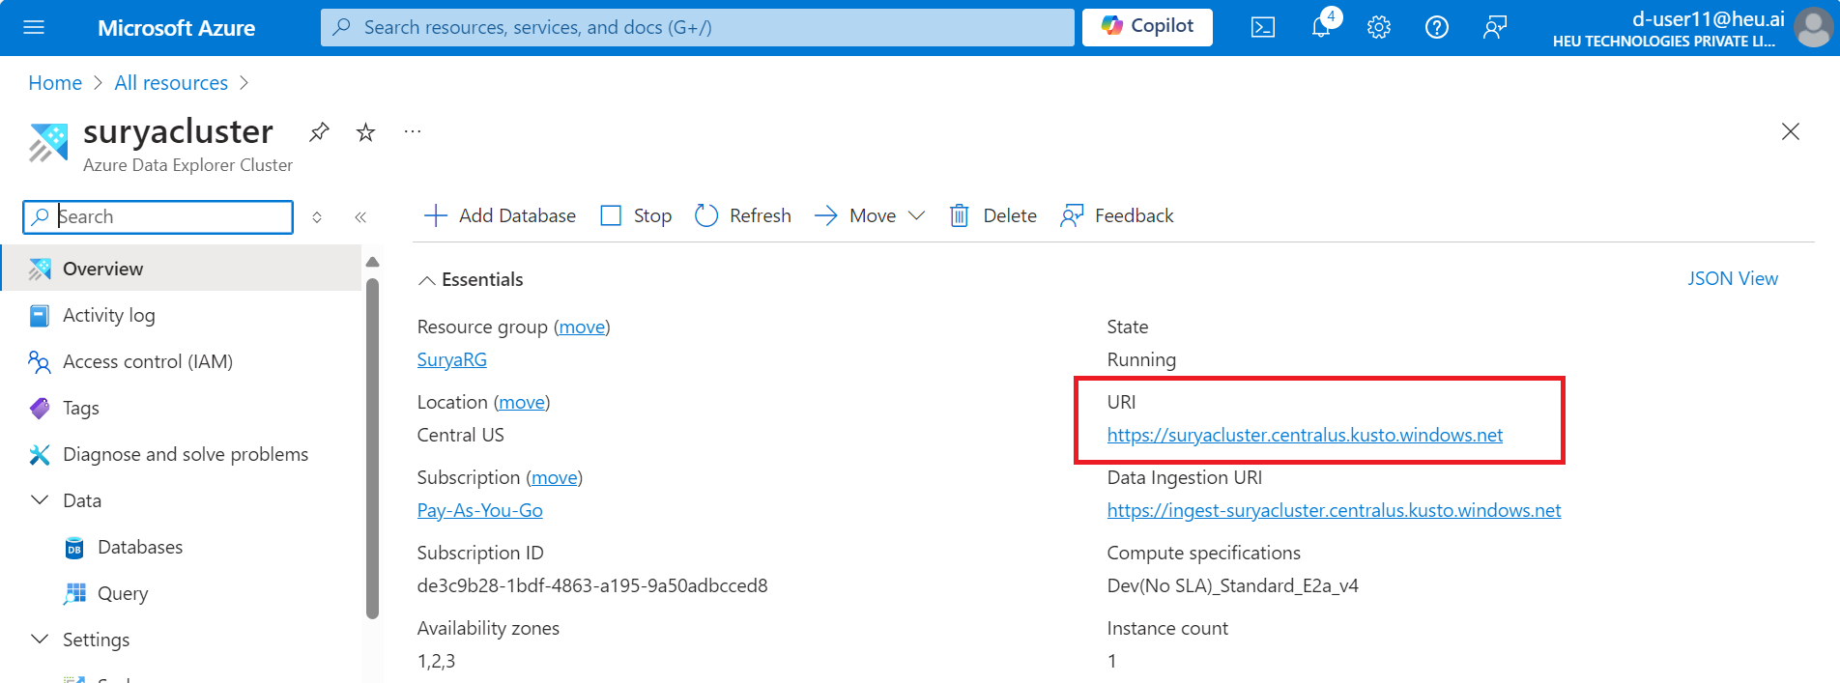
Ingestion wizard in Azure Data Explorer (ADX)
27. Copy URL

Slide 40
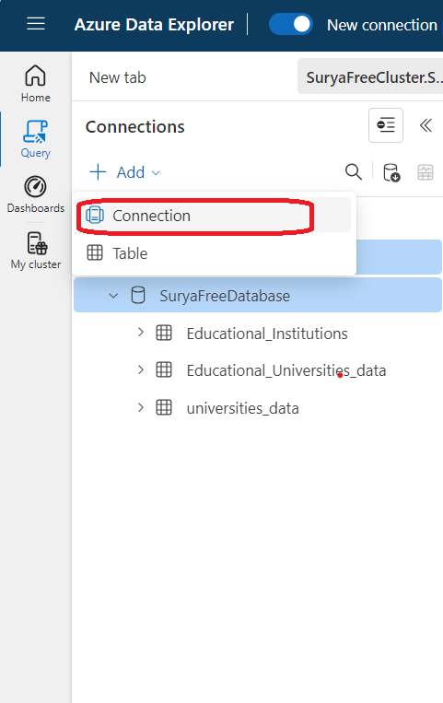
Ingestion wizard in Azure Data Explorer (ADX)
27. Navigate to https://dataexplorer.azure.com/ -- Query – Add Connection – PAste URL

Slide 41
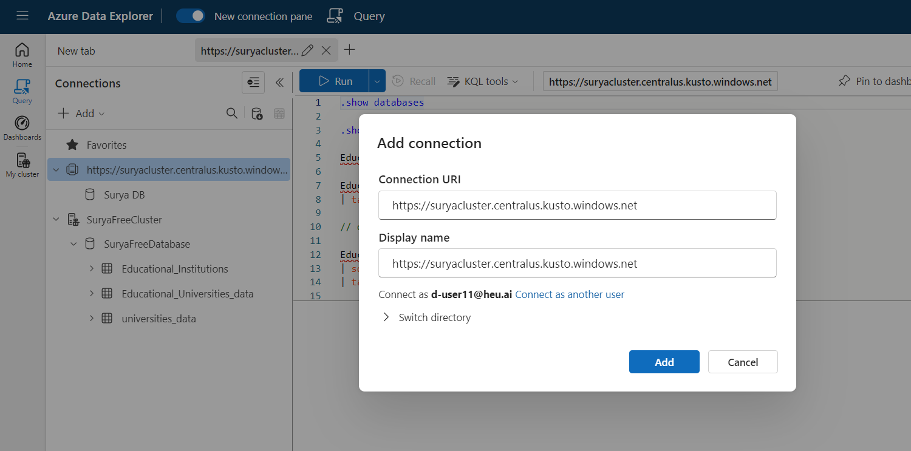
Ingestion wizard in Azure Data Explorer (ADX)
28. Navigate to https://dataexplorer.azure.com/ --Add Connection – Paste URL

